Slide 1
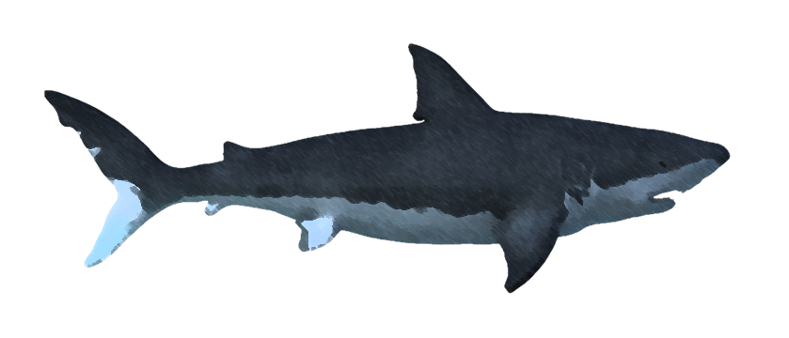
MODS: Prehistoric Florida
Marcus Elosegui - Java
Frankie Prozor - Graphics
Jarrod Maloney - UI
West Broward High School

Slide 2
Objective
Our goal for our app was to both enhance the prehistoric Florida museum exhibit, itself, and to provide new information in both a fun and enlightening manner.
To highlight some features of the exhibit that guests may have missed or been confused about

Slide 3
App content
Trivia Game
Animation and information about sea level changes in Florida’s past
Information and pictures about prehistoric animals that lived in Florida
Expand on the dig pit to give “paleontologist’s” more info about the fossils they dug up
Provide fun facts about fossils, their formation, and paleontology in general.

Slide 4
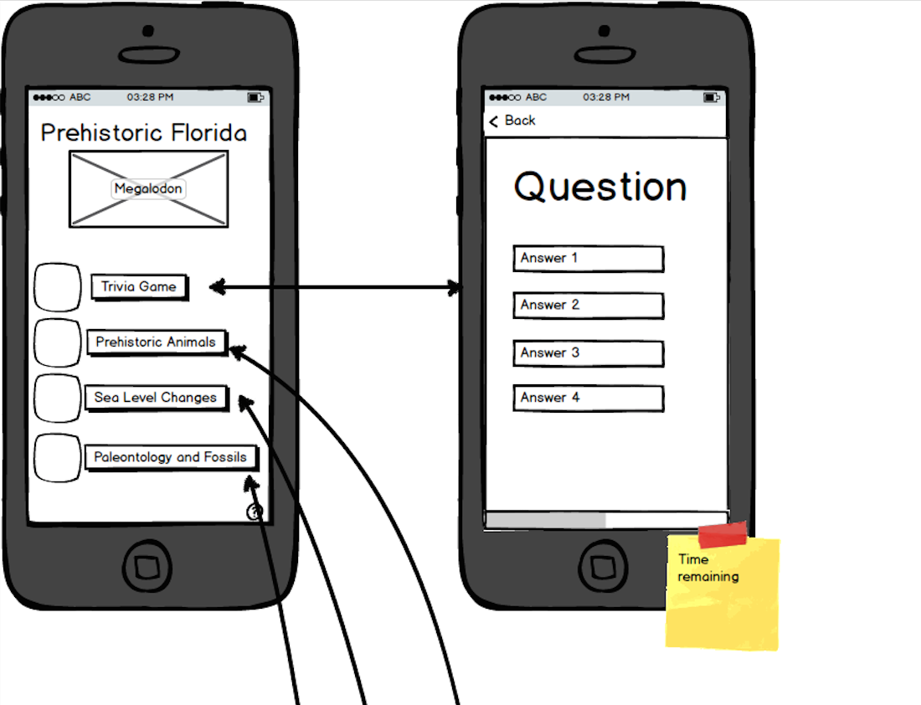
Mockups

Slide 5
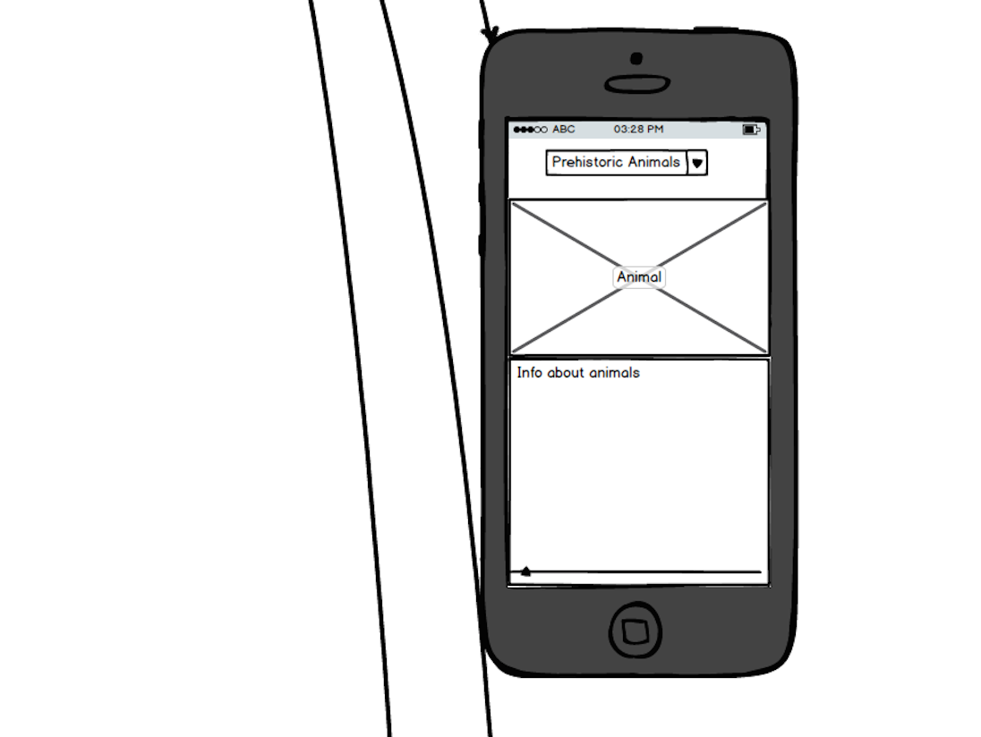
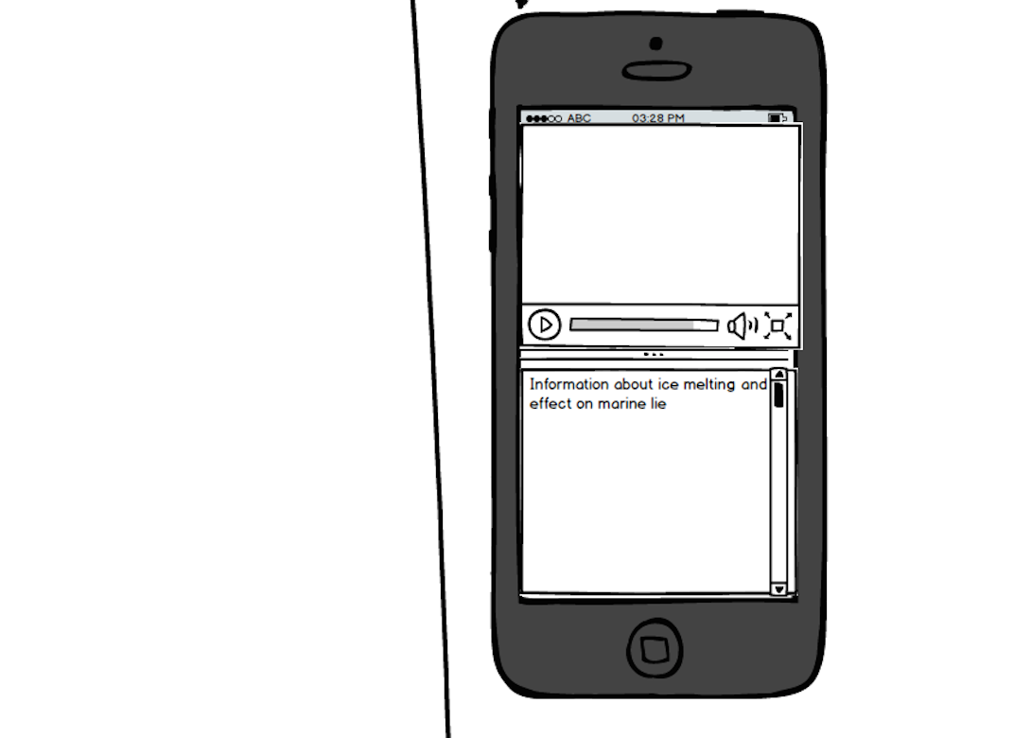
Mockups

Slide 6
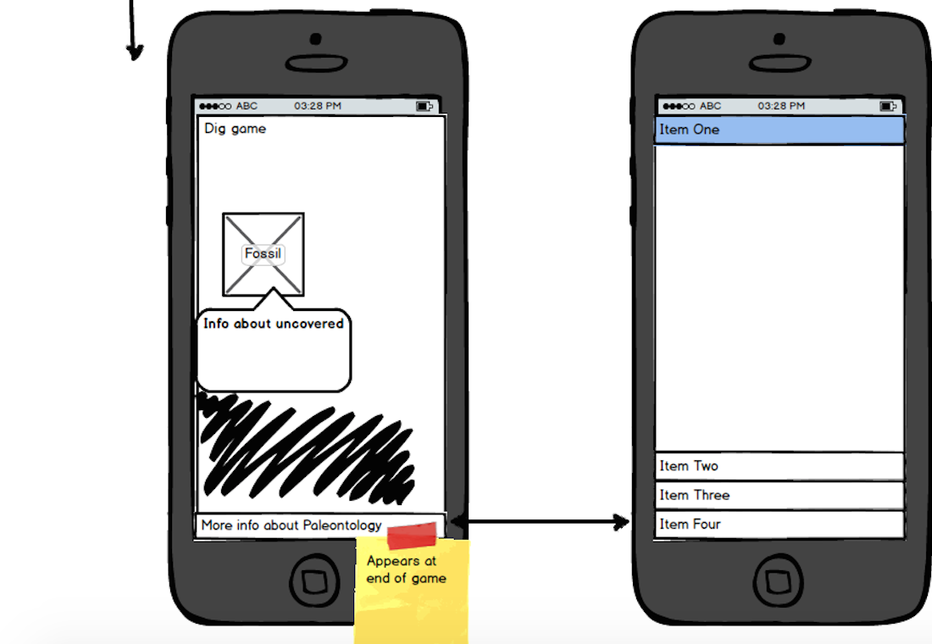
Mockups

Slide 7
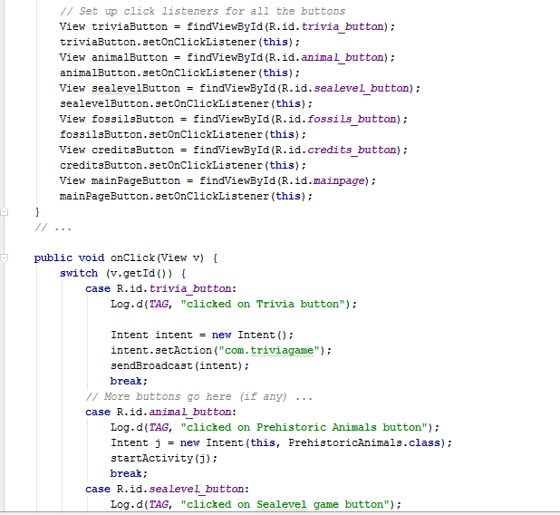
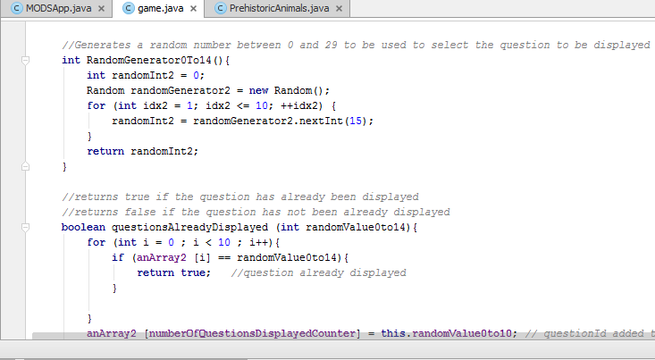
Java

Slide 8
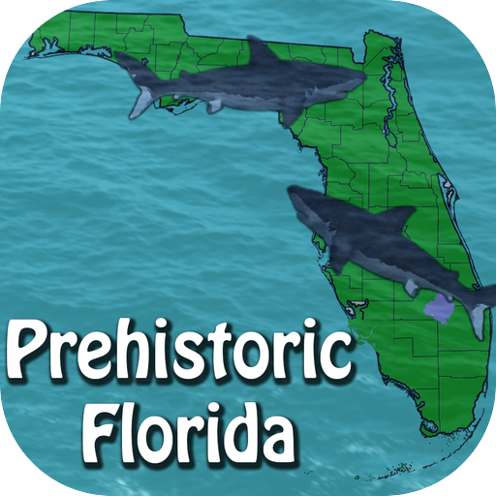






Graphics
Primary layout of the app is based on similar colors to the MODS website color scheme.
Drop shadows were added around the buttons to add depth.
Icons are next to the buttons on the prehistoric florida menu to add a fun way to summarize where the button brings you.

Slide 9
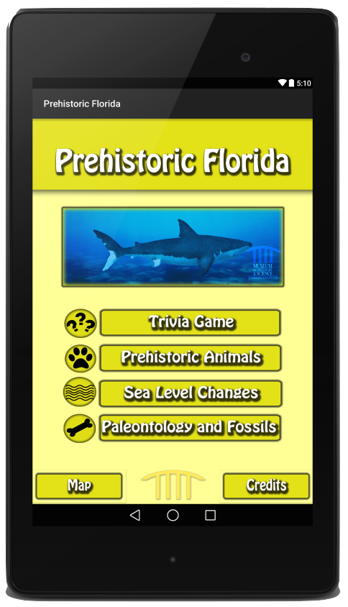
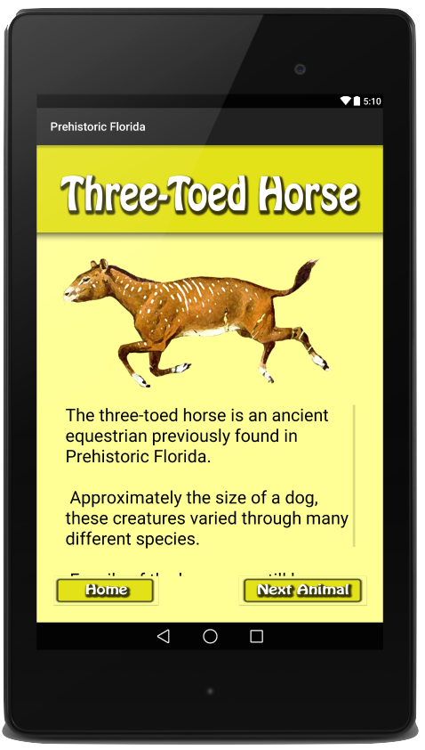
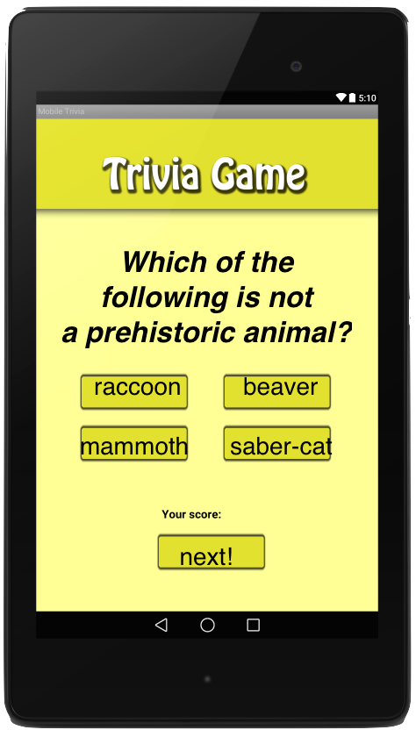
UI
Primarily Composed of of linear layouts
Occasional grid layout, as seen with the buttons in the trivia game
Scrollable textviews as to reduce clutter
Facts separated into paragraphs by topic
Consistency of buttons and backgrounds through the app
Easy to know your way around the app

Slide 10
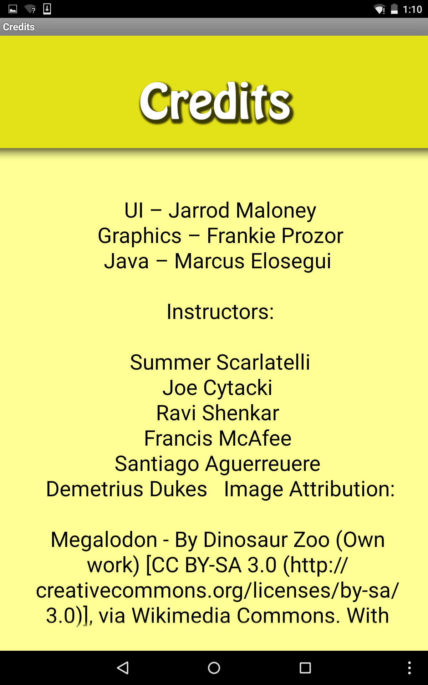
Credits
Thanks to:
Summer Scarlatelli
Joe Cytacki
Ravi Shenkar
Francis McAfee
Santiago Aguerreuere
Demetrius Dukes
United Way
Special thanks to Florida Atlantic University and the Museum of Discovery and Science

Slide 11
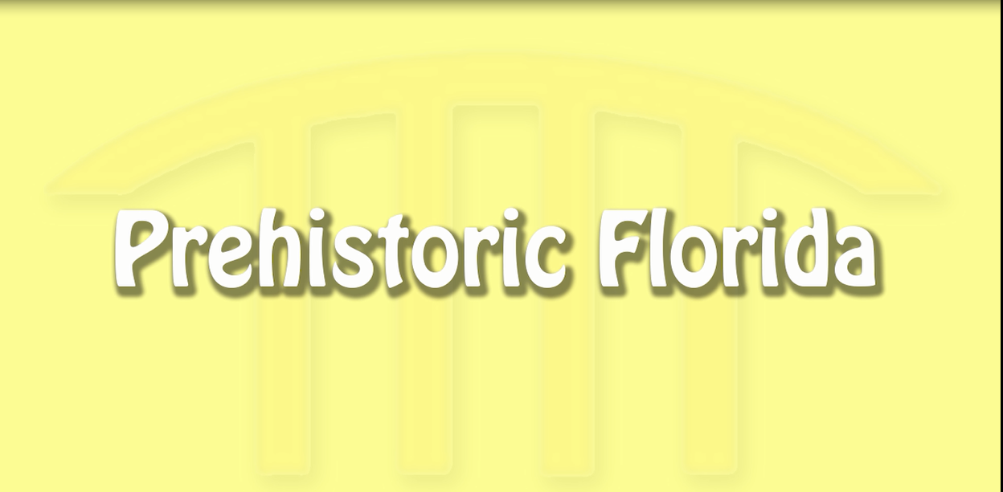
Video

Slide 12
Any Questions?

